Slide 1

Typing Guru
Best Typing Tutor Application To increase Your Speed

Slide 2
Project Developed BY :
Abdhesh Nayak
Unv.Roll : 1701448
Branch : B.Tech IT
Developed At:
Amritsar Group of Colleges, Punjab,
India (July 2019)

Slide 3

Languages used in this project
Java is Base Language which i used in this project

Slide 4

JetBrains
INTELIJ IDEA
engine used for coding

Slide 5

Introduction
I choose to create Typing Guru using Java as a main Technology and Designed it using JavaFx and HTML,CSS. In this application there is 2 Type of Users Admin and Normal User. The First User of the application will be the Admin and Admin can Delete any User without knowing The Password of that user and Normal User can delete there own userID only. There is verity of Lessons and Stories For User Practice. At present Time this application supports 7 Languages (English, Hindi, Nepali, Punjabi, Bengali, Tamil, Urdu) more can be added without making changes in the coding. So this is overview of our application so now lets talk about it how we create it and how we use technologies in it.

Slide 6
What we need to install before we start coding
first we need to install engine in which we write our code like we choose Intelij idea.
Another is jdk I installed jdk_1.8 on my local machine And used it to compile and run the program.

Slide 7
Difficulties while adding features in application
After the completion of my project when tried to export it for the users it shows me jdk 11 not supports fxdeploy.
the problem was I Used jdk11 which comes without javafx bundle so I Learned it form google and changed the jdk11 to jdk 1.8 and then my problem is solved.

Slide 8
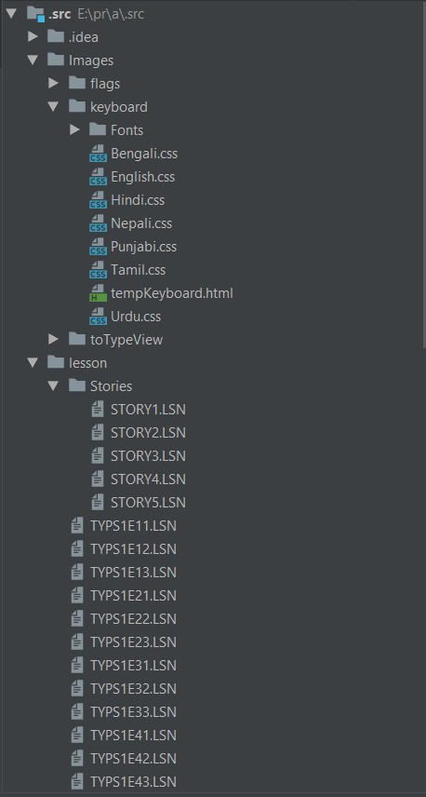
This is the Source Files
In this Files I Stored the Graphics Components and the Data used in the application. Here is HTML, CSS files for graphics design, Stories and Lessons for User Practice, Images for graphics Design and etc. The size of this file is 910kb only.

Slide 9
On which platform this application can run now
Now I am exported it for window 10. n window 10 it can be run independently without jdk or jre I am included required jre int the installer file so user don’t need to install jre or jdk.
Another is Linux in Linux platform also it can be used without installing jdk or jre it can be run directly by double click on the executable file. Because of it include jre the size of file is around 62 mb.
Download link : gg.gg/TypingGuru

Slide 10
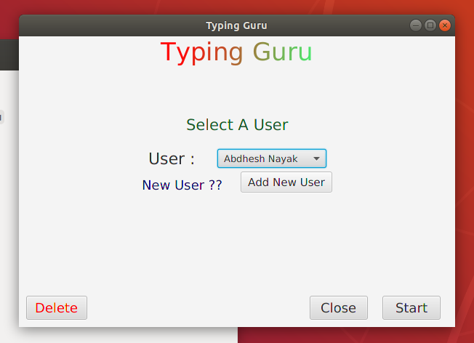
This login page for All Registered Users
There is a guest user which is not required password to Login. Others will be needed password to Login. From this screen we can also add new users or delete a old user which is not required in the application.

Slide 11
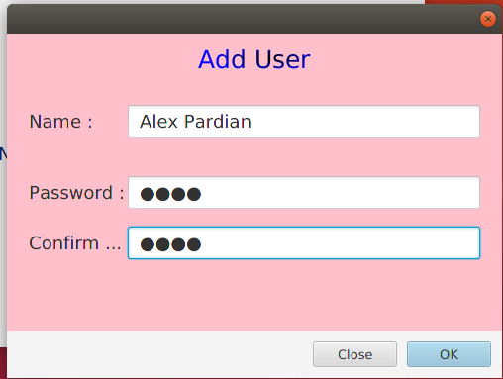
This is page on which we can add a new User
IF user already present in the database or if password not match then it shows Warning.

Slide 12
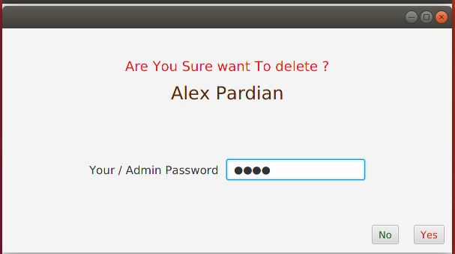
This is page on which we can add a new User
To delete a user you need to add admin password or password of the that user. If the password entered wrong then the warning will be appear.

Slide 13
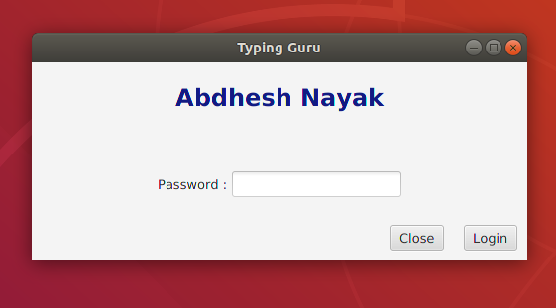
This is page on which User tried to login for practice
To Start Practice the user needed to give there password if password will be wrong then the warning will be appear on the screen.

Slide 14
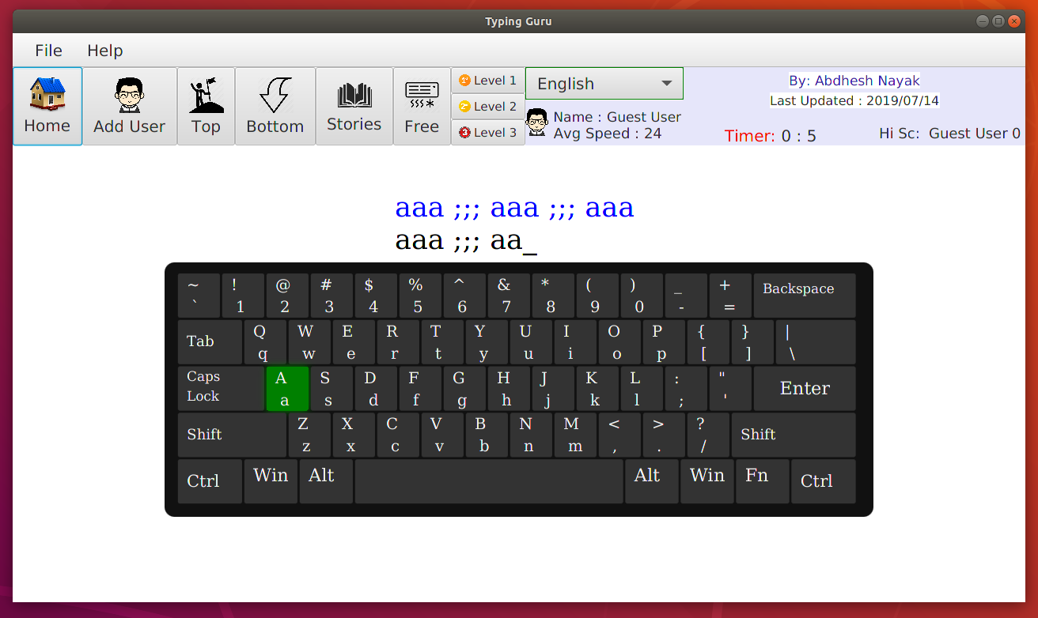
This is the main window where user start practice
Here to start practice user needed to select a level and language in which user wants to practice. User needed to the letter which is shown on the screen with green color. If user will type wrong letters then that wrong letters will be show with red color.

Slide 15
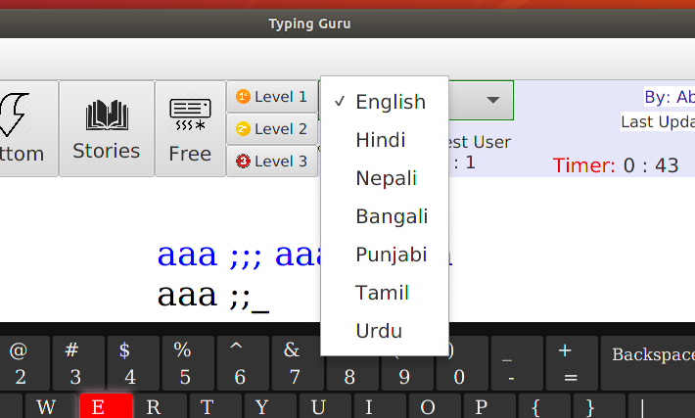
User can practice in 7 languages
When user will click on the language then a drop down menu will be shown then user needed to select the language then they can start practice in this keyboard of this language.

Slide 16
This is the practice screen with English keyboard type

Slide 17
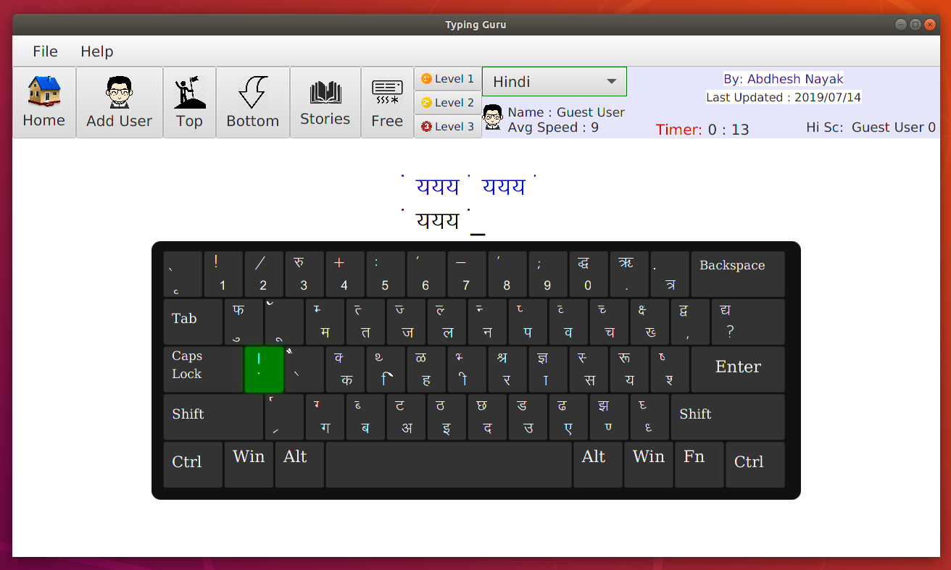
This is the practice screen with Hindi krutidev keyboard type

Slide 18
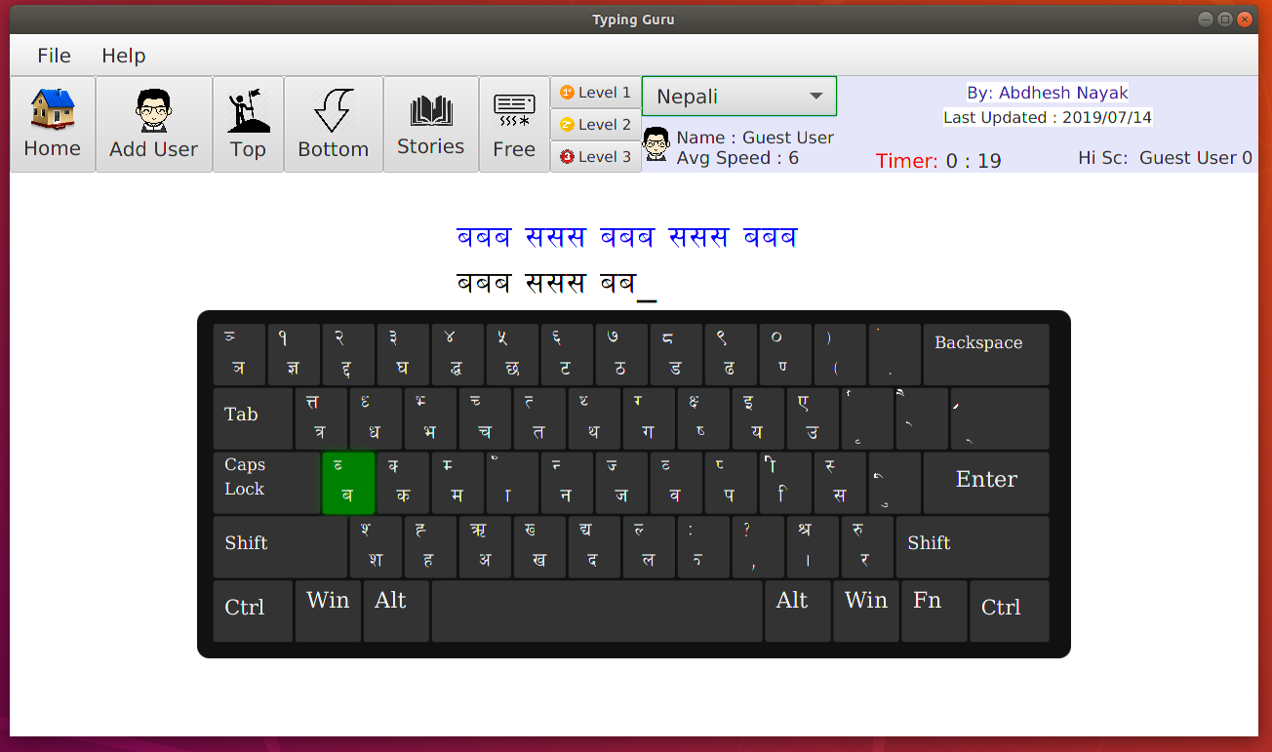
This is the practice screen with Nepali Keyboard Type

Slide 19
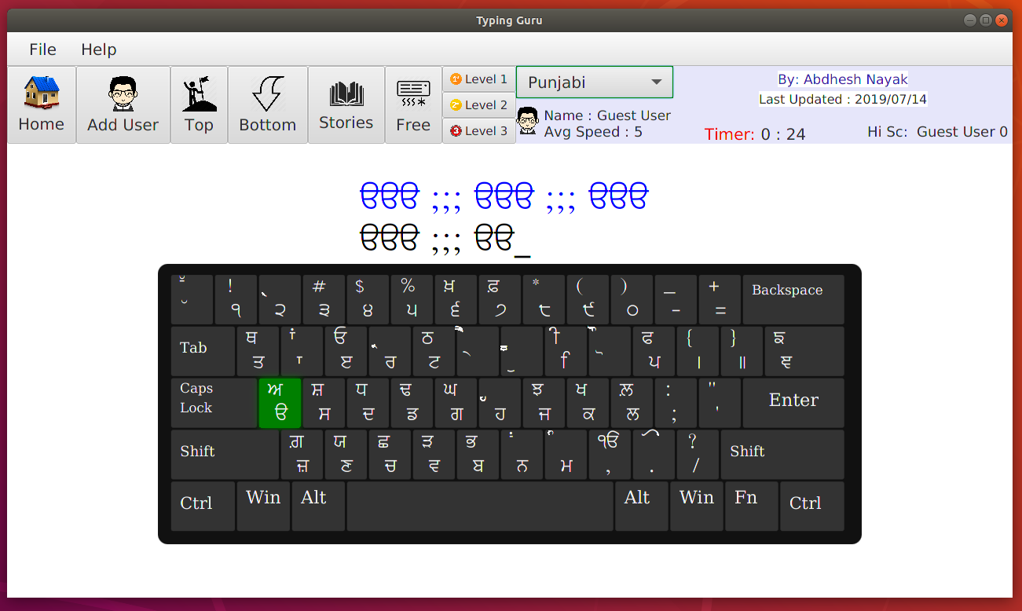
This is the practice screen with Punjabi keyboard type

Slide 20
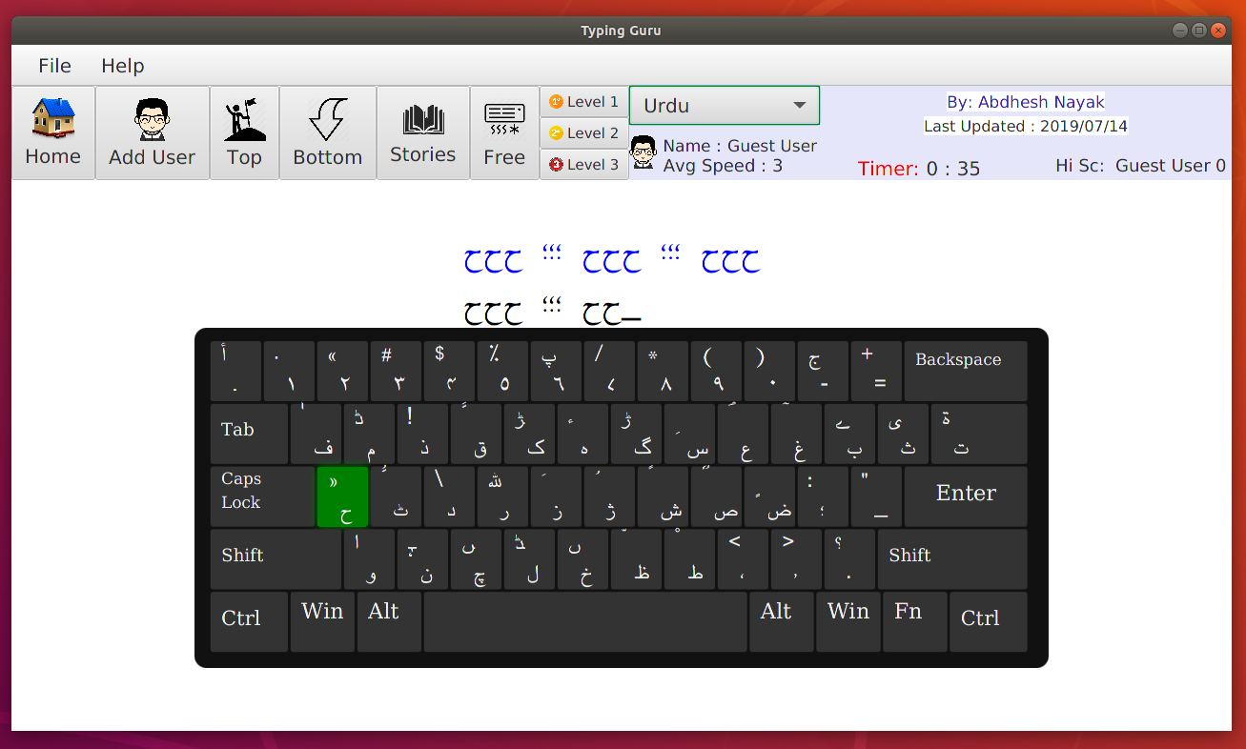
This is the practice screen with Urdu keyboard type

Slide 21
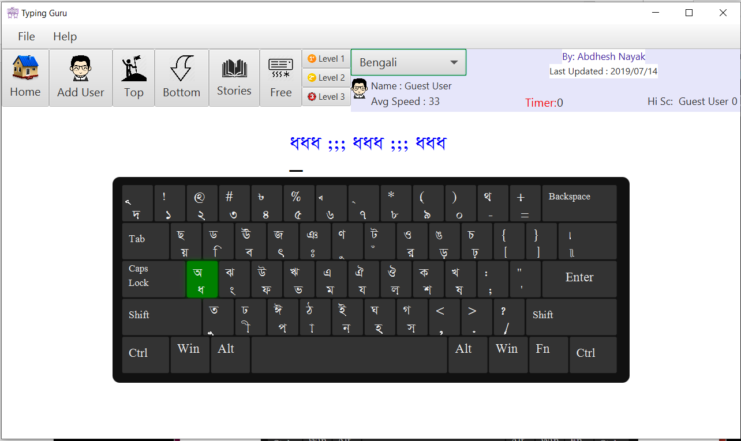
This is the practice screen with Bengali keyboard type

Slide 22

This is the practice screen with Tamil(Telegu) keyboard type

Slide 23
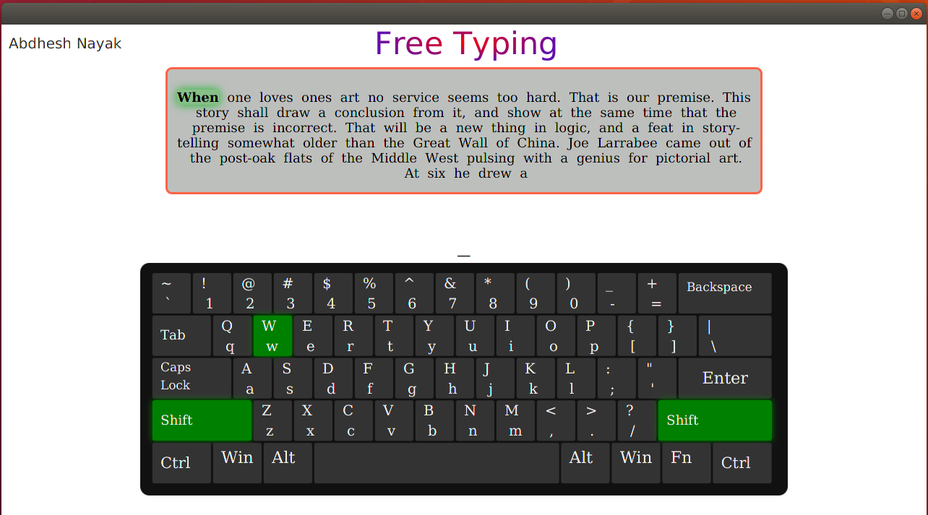
This is the practice screen with a random story

Slide 24
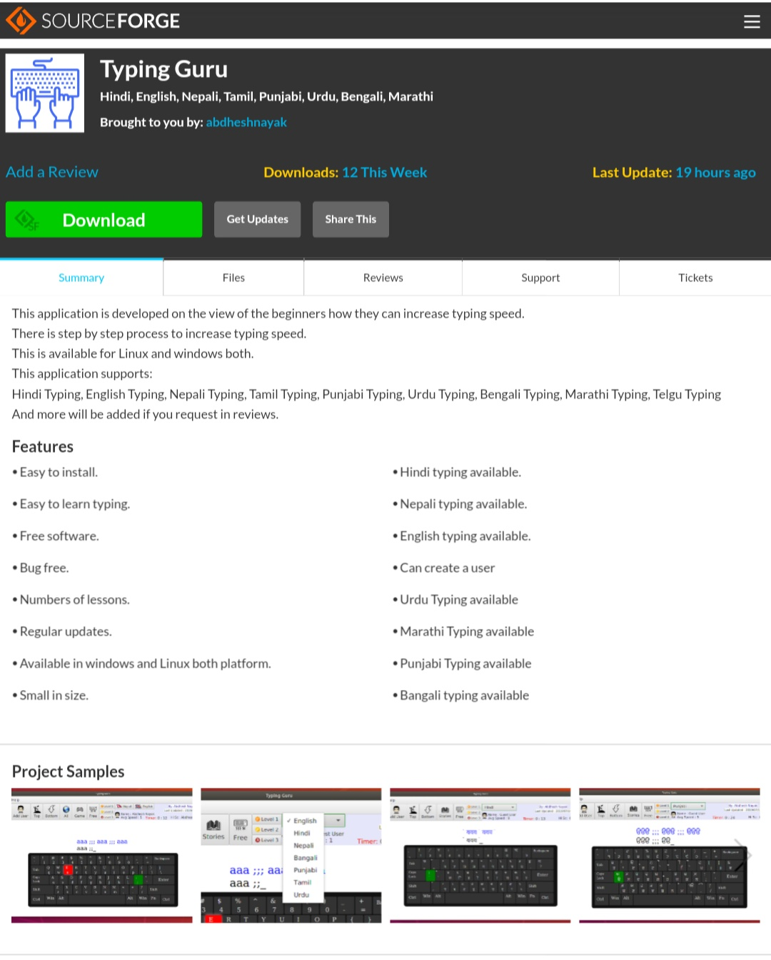
Download Page
This is the page from where you can download this application as your requirement.

Slide 25
Thank You

Slide 26
Any question Please ???

